Slide 1
Visualizing Adidas Sales: A Tale of Recovery, Profits, and Regional Footholds Amidst 2020-2021 Challenges
By ASAPH NII AYITEY SOWAH – B01224308

Slide 2
RATIONALE FOR SELECTING ADIDAS SALES DATA.
Exploring Adidas sales data in the vibrant US market aligns with my passion for sports and sportswear. It's more than academic interest—it's a chance to understand industry dynamics in a diverse market. The US, known for its varied sports culture, offers insights into Adidas's strategies across genders. The dataset's depth—sales figures, regional perspectives, and product classifications—promises valuable observations. This exploration uncovers consumer behaviors and impacts real-world marketing and business decisions in sports retail. It merges my love for sports, fashion, and practical exploration, transcending data analysis into a narrative echoing my passion for sports and cultural significance in athletic apparel for both men and women.

Slide 3
Adidas Dataset Exploration
During the COVID-19 pandemic in 2020, Adidas sales saw a significant downturn across retailers but showcased a remarkable recovery in 2021. This resurgence was accompanied by increased unit sales, notable profit growth for retailers, and a shift towards online sales. Regional analysis highlighted significant sales growth in specific regions for both men's and women's apparel and footwear. The data suggests adaptive consumer behavior, a correlation between sales and profitability, and demonstrates Adidas's resilience in navigating market challenges.

Slide 4
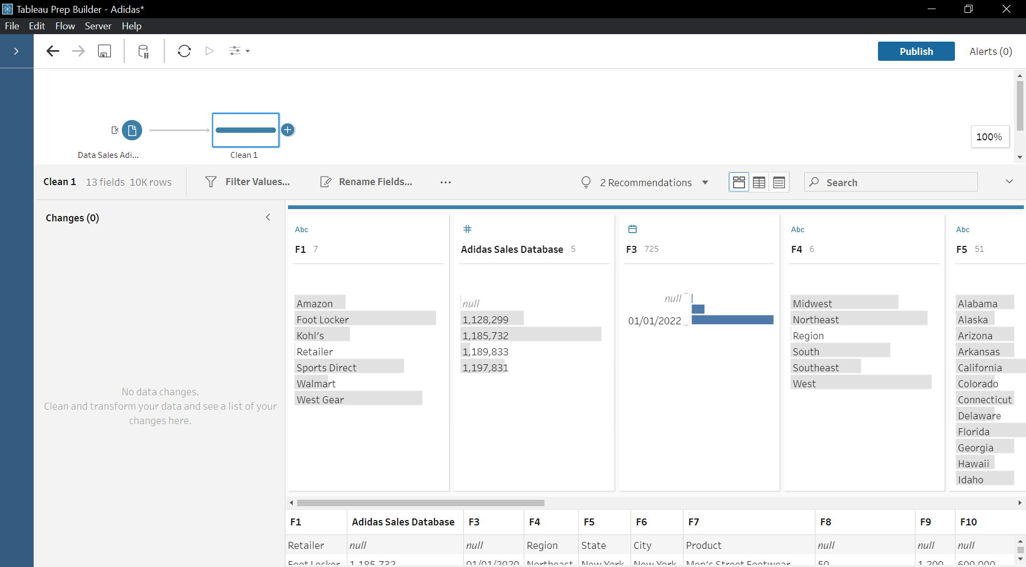
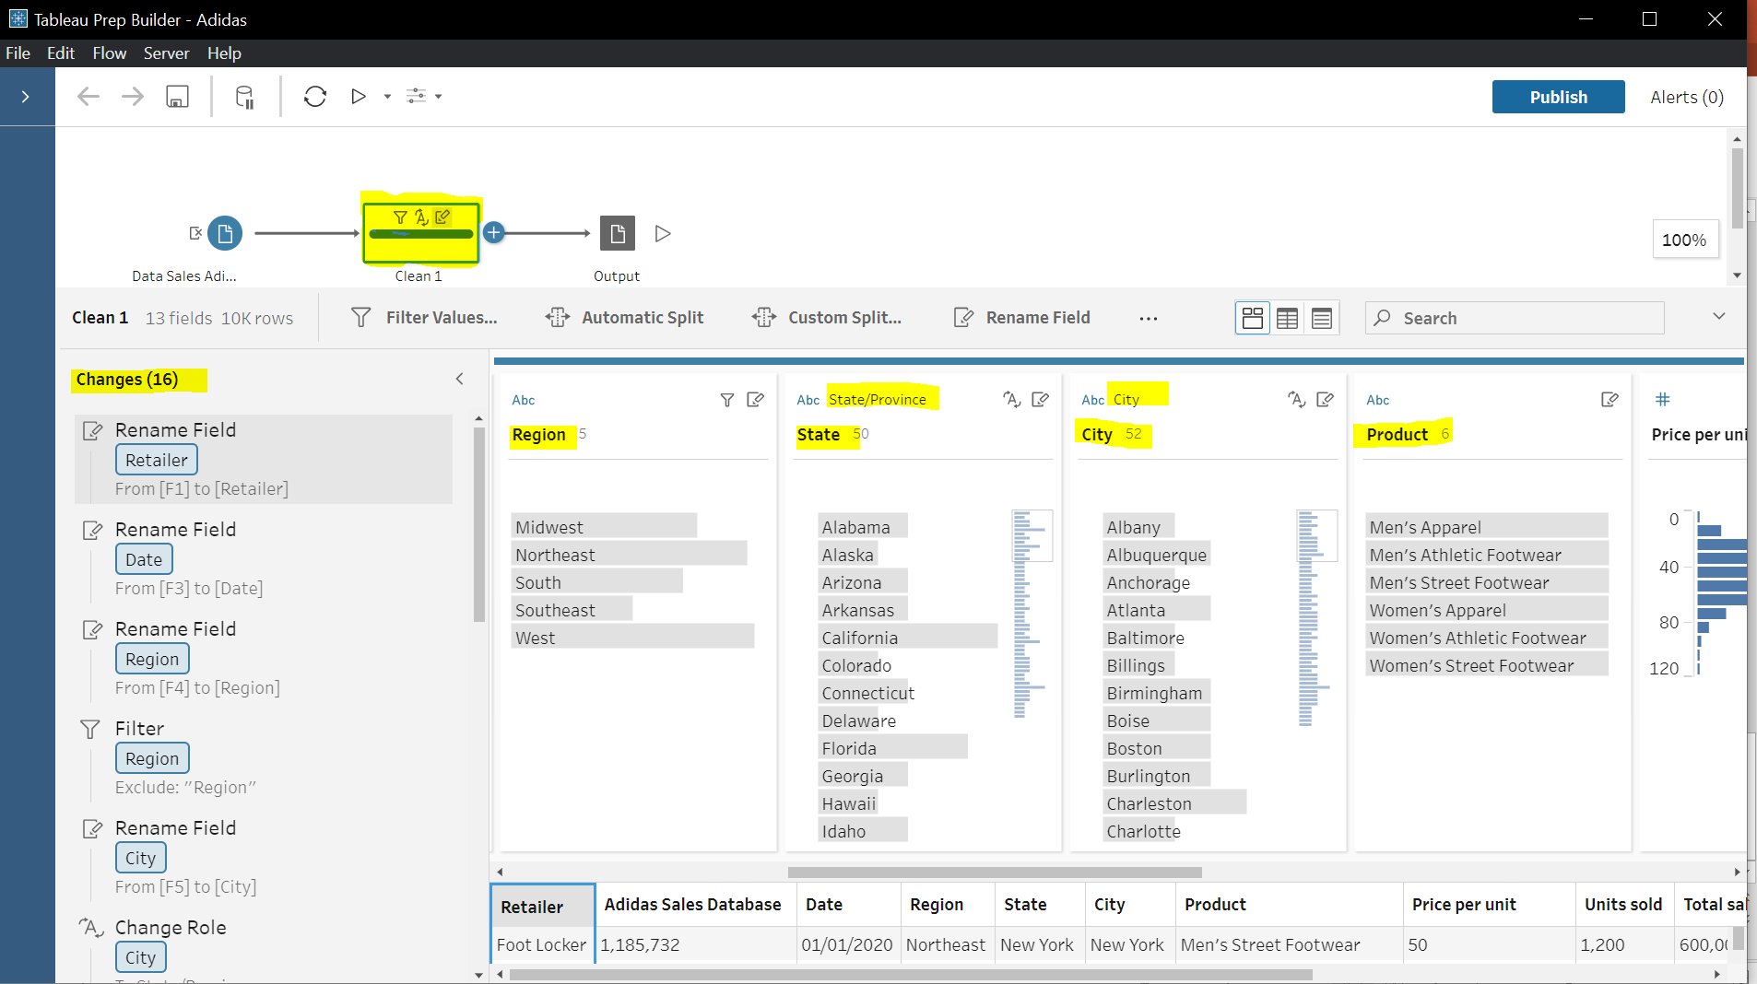
DATA CLEANING AND TRANSFORMATION
Enhanced Clarity:
Renaming Field Names: Improved understanding by renaming fields to more descriptive and intuitive names.
Eliminating Unnecessary Attributes: Removed redundant or irrelevant attributes for more streamlined and manageable data.
Improved Relevance:
Streamlining Dataset Focus: Focused on pertinent information, enhancing the dataset's relevance for targeted analysis.
Optimizing Dataset Usability: Enhanced usability by refining the dataset, allowing for more precise and effective analysis.
Enhanced Readiness:
Preparing for Visualization: Ensured accurate and effective visualizations by preparing the dataset for graphical representation.
Increased Analytical Readiness: Enhanced the dataset's readiness for in-depth analysis, enabling the extraction of insightful conclusions and trends.
NB: First Picture: Uncleaned and untransformed data
Second Picture: Cleaned and transformed

Slide 5
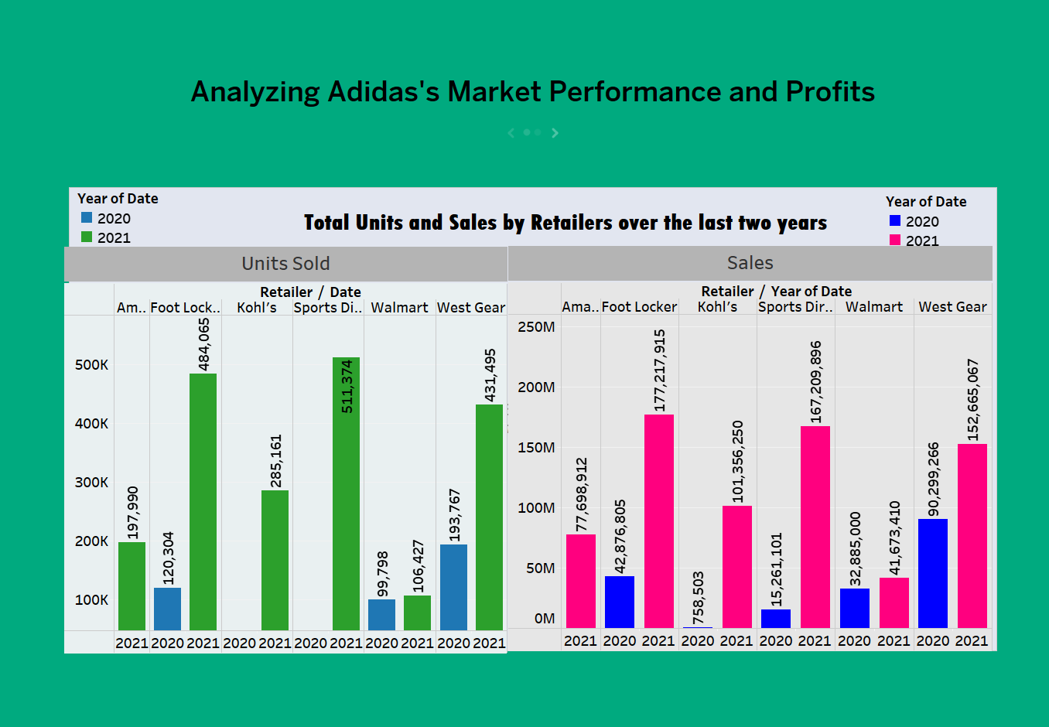
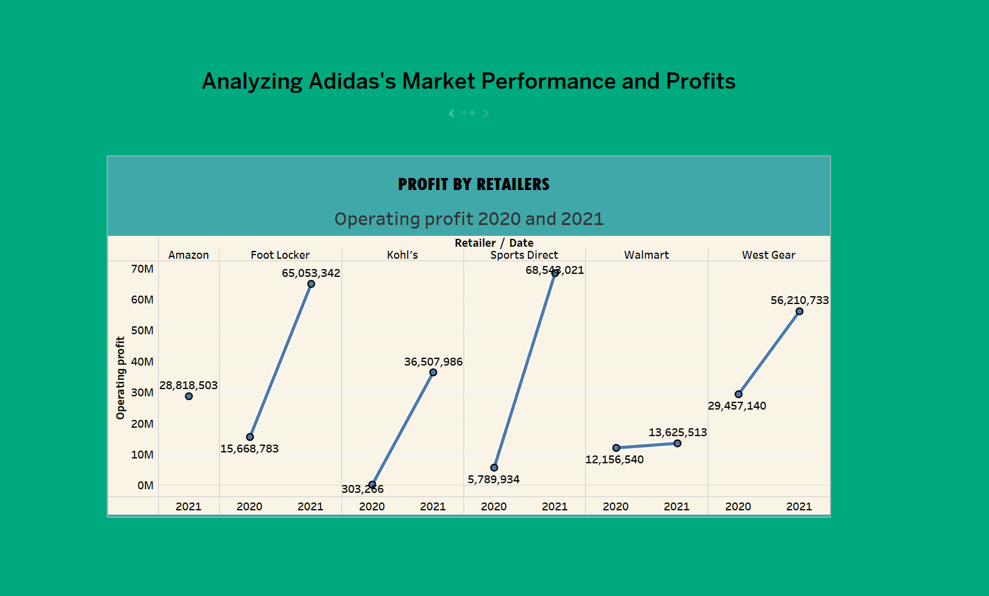
Story Telling – Market performance and Profit
Introduction: Overview of varied sales trends due to COVID-19 in 2020 and resurgence in 2021.
Key Insights:
Sales trends for Foot Locker and Kohl's in 2020 and 2021.
Retailers' operating profit increase (Sports Direct, Foot Locker).
Correlation between Adidas sales and retailers' profit.
Bar Chart: Compares sales across different product categories or years.
Line Graphs: Depicts sales trends over time for specific product categories.

Slide 6
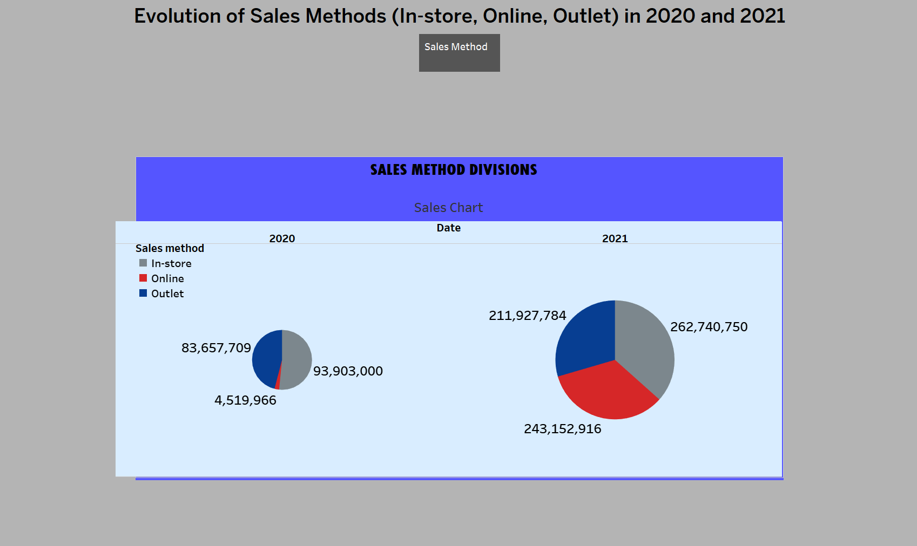
Sales Methods Analysis
Introduction: Analysis of sales methods (In-store, Online, Outlet) during 2020 and 2021.
Key Sales Insights:
Surge in in-store, online, and outlet sales from 2020 to 2021.
Staggering rise in online sales indicating a shift in consumer preferences..
Pie Chart: Illustrates the proportion of sales for sales method.

Slide 7
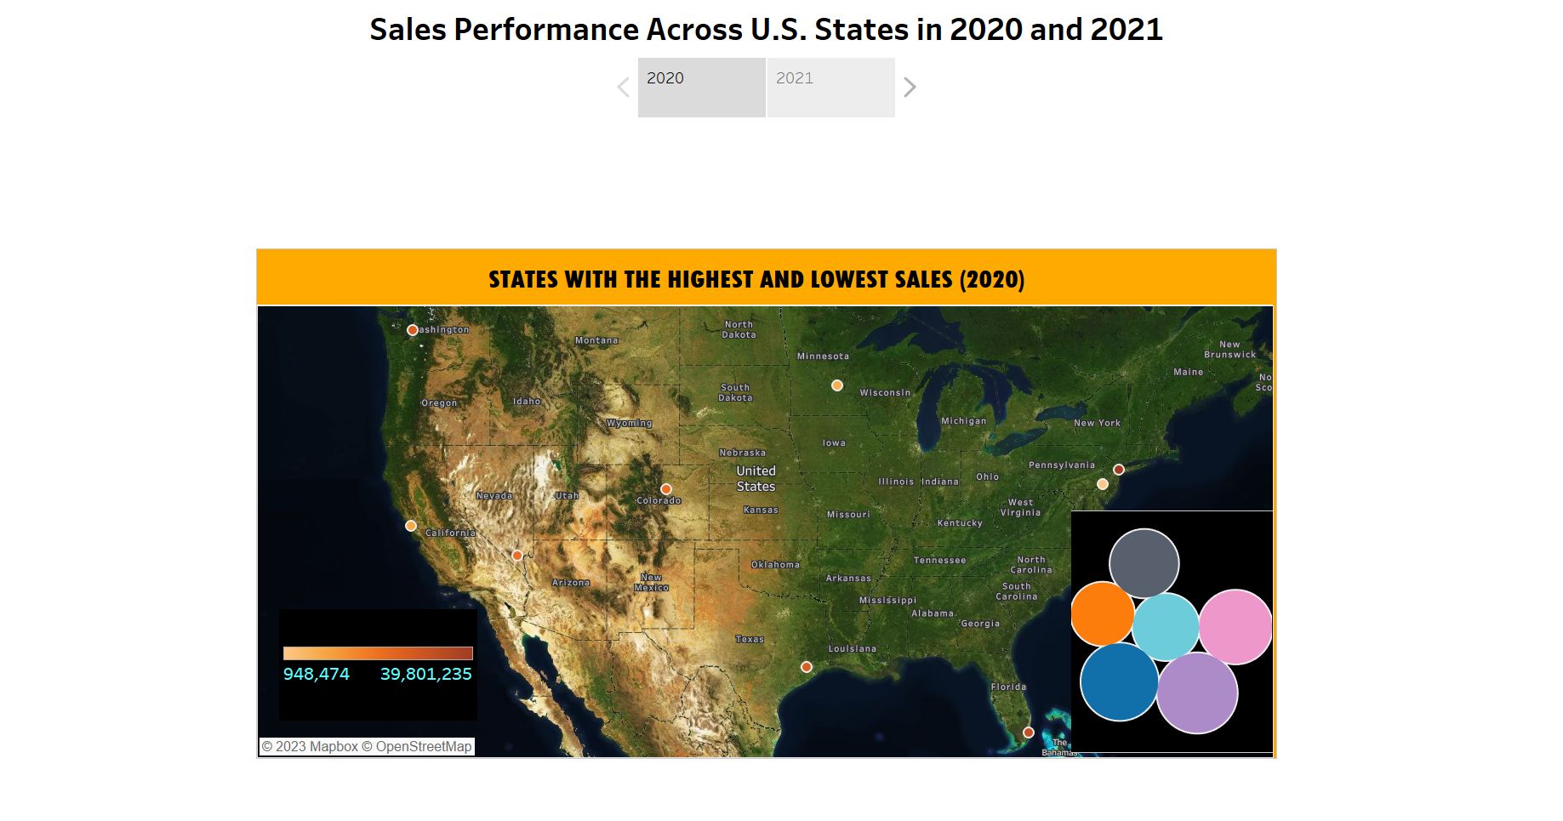
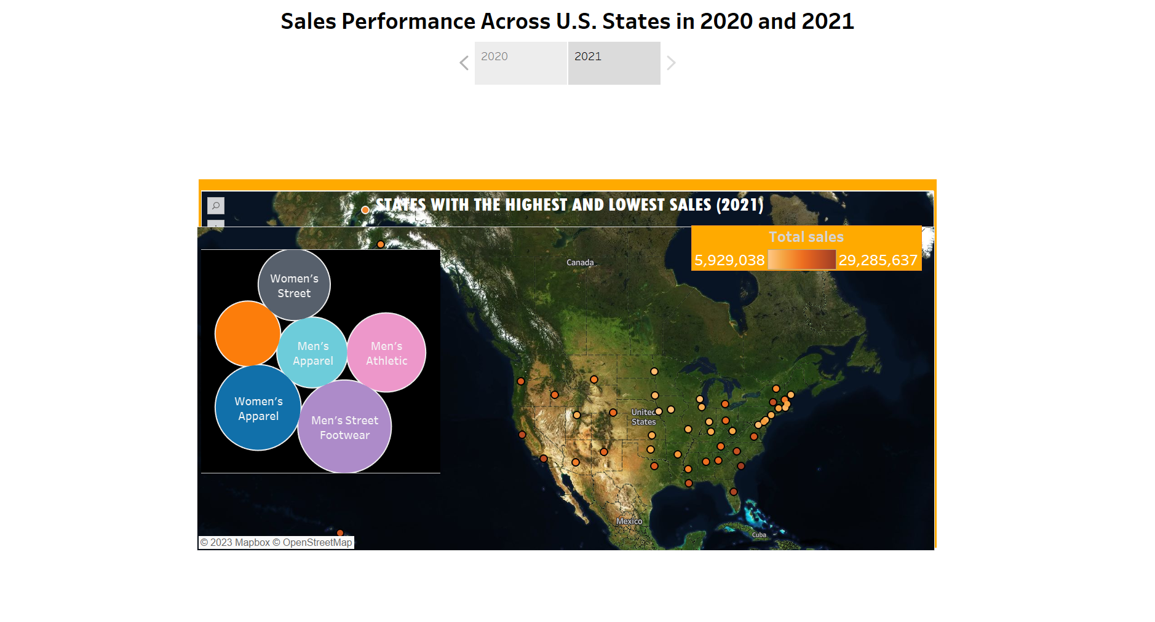
U.S. City Sales Analysis
Introduction: Overview of sales performance across U.S. cities in 2020 and 2021.
Key Insights:
Sales highlights for New York, Miami, and Charleston.
Consistency in sales performance in established cities and emerging growth in Charleston.Maps: Visualizes sales geographically across regions or locations.

Slide 8
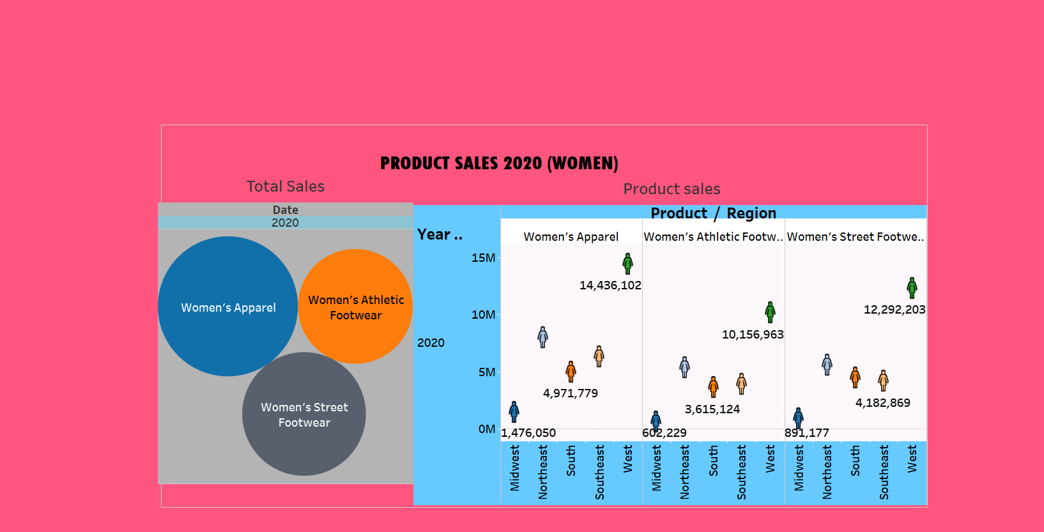
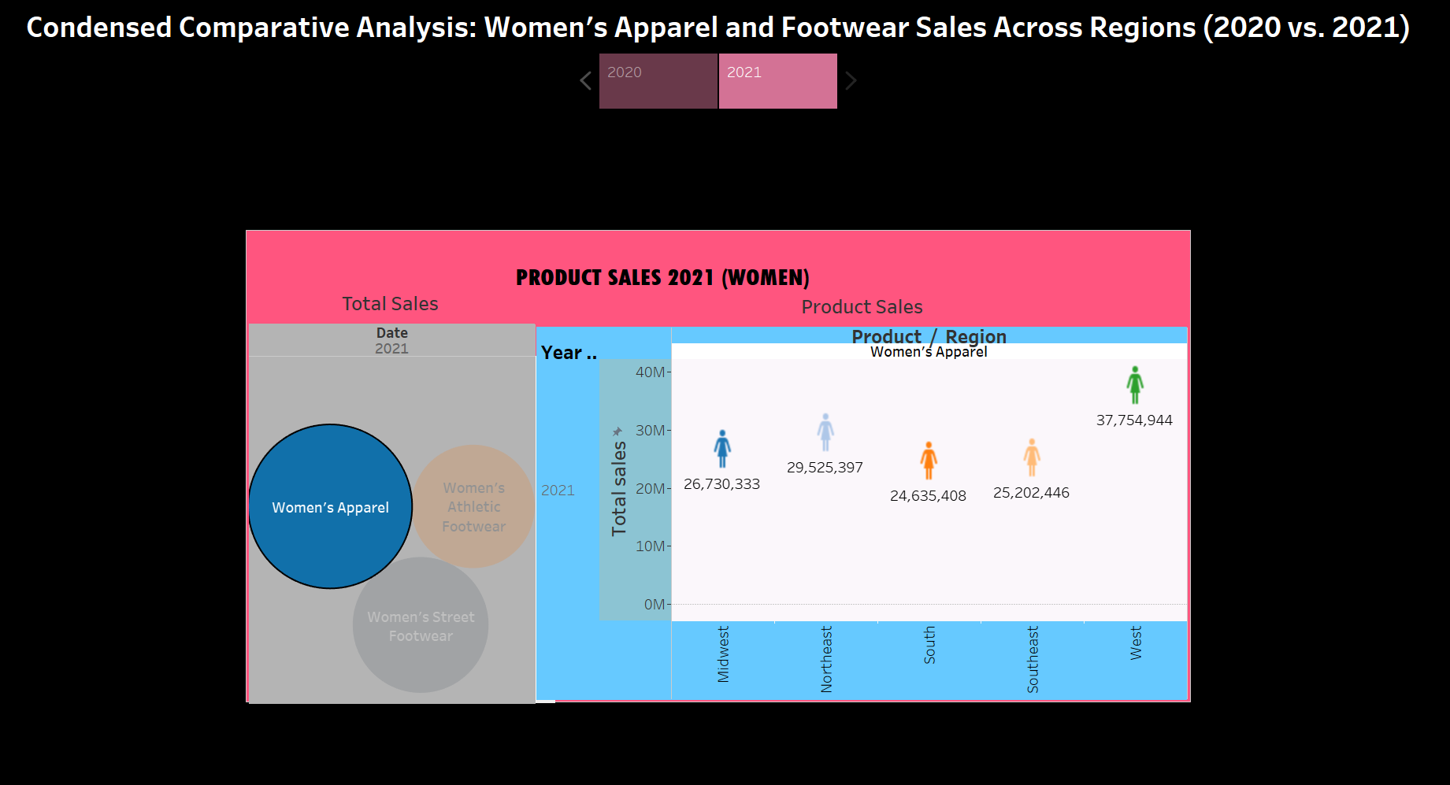
Comparative Analysis: Women's Sales Across Regions
Introduction: Summary of sales trends for women's apparel and footwear across regions.
Key Sales Trends:
Growth in sales for women's apparel and footwear (Northeast, West).
Dominance of the West in athletic and street footwear sales.
Regional dominance of Northeast and West.
Scatter Plots: Shows relationships between sales and Products in a period of time.

Slide 9
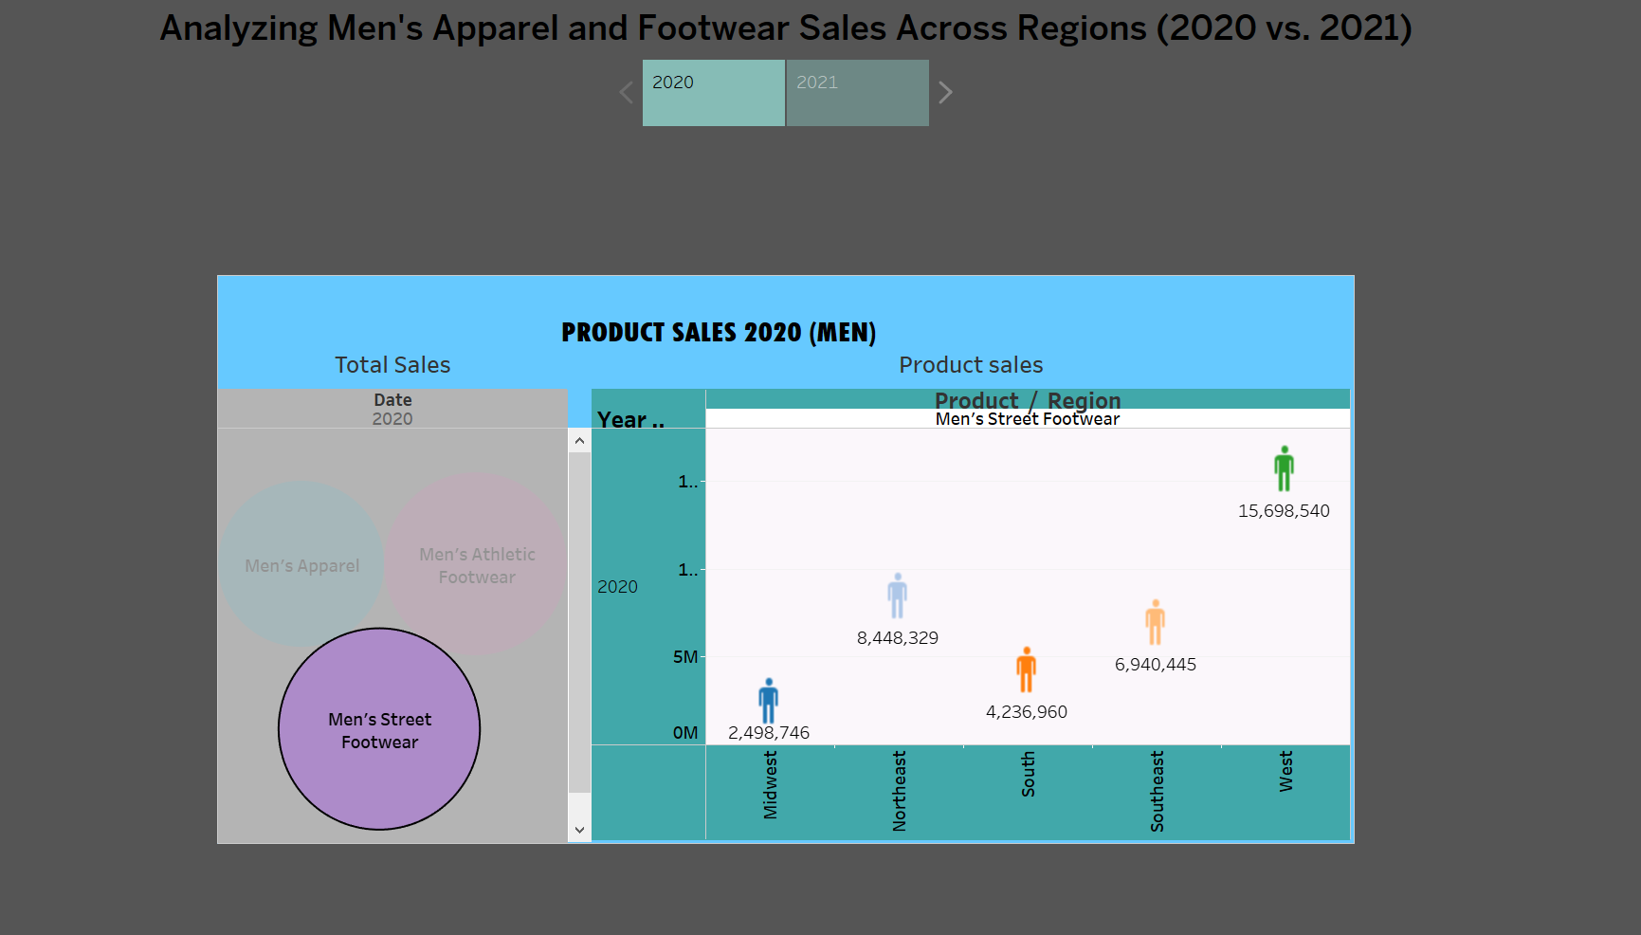
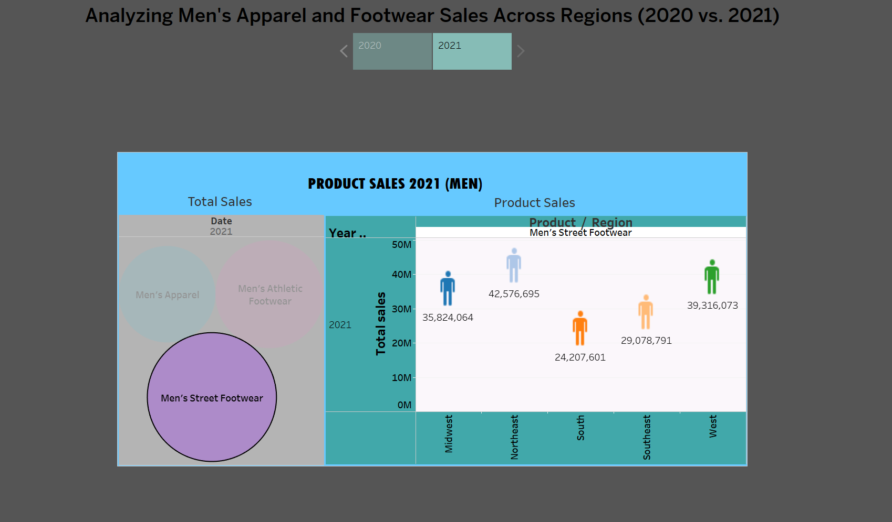
Comparative Analysis: Men's Sales Across Regions
Introduction: Overview of sales data for men's apparel and footwear across regions.
Key Sales Insights:
Sales trends for men's apparel, athletic footwear, and street footwear.
Comparative analysis showing growth and regional dynamics.
Scatter Plots: Shows relationships between sales and Products in a period of time.

Slide 10
SUMMARY
Through comprehensive data analysis and visualization, it's evident that Adidas, as a global sportswear brand, has demonstrated resilience and market strength across diverse regions, despite challenging circumstances such as the COVID-19 pandemic. The sales data indicates a strong foothold in key regions like the Northeast and Midwest, while also showcasing consistent performances in the Southern, South-eastern, and Western markets. This market diversity underlines Adidas's adaptability and appeal to a wide range of consumers, reflecting its robust position in the competitive sportswear industry.“
LINK TO MY YOUTUBE ANALYSIS OF THE DATA : https://www.youtube.com/watch?v=otwWPsrX25k

